Slide 1
Chapter: 1.1
The atom

Slide 2
Atomic particles
Atomic particles:
An atom contains three subatomic particles- the proton, the neutron, and the electron.
Symbols, charge and masses of atomic particles
https://www.youtube.com/watch?v=FSyAehMdpyI&list=PL8dPuuaLjXtPHzzYuWy6fYEaX9mQQ8oGr&index=1
Particle | Symbol | Charge | Relative mass
Proton | p | +1 | 1
Neutron | n | 0 | 1
Electron | e | −1 | 1/1800 (approx.)

Slide 3
The nucleus of an atom is a very small region of space that contains all the protons and neutrons. The nucleus contains most of the atom, but occupies only a small volume of the atom. Surrounding the nucleus are the electrons.
Electrons are very small, move extremely fast, and are spread out over a relatively large distance. This creates an electron cloud around the nucleus. Despite the large amount of space they cover, electron contribute almost no mass to the atom.

Slide 4
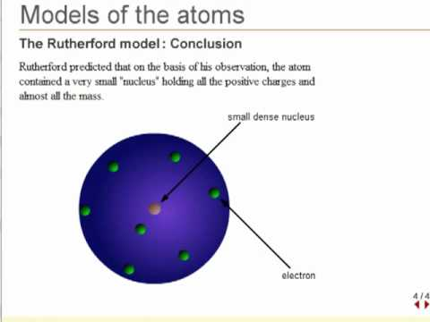
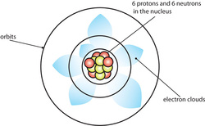

Slide 5
The current model of the atom was initially theorised by Ernest Rutherford in the early 1900s after an experiment in which he fired alpha particles at a thin sheet of gold foil.
Earlier models of the atom suggested that all the particles would be evenly spread throughout the atom. It was thus expected that the alpha particles would pass through the gold foil with little or no deflection.
Rutherford found that a small number of the alpha particles experienced a significant deflection as though they had struck something large. This did not support his hypothesis and led to Rutherford theorising that most of the atom was in a structure in the centre. This structure is the nucleus, which contains all the protons and neutrons.

Slide 6
Atomic representation
A substance made of only a single type of atom is called an element. Elements can be represented by symbols.
Sometimes elements are represented by letters that do not occur in their names. These symbols are based on the element’s Latin, Greek or German name. e.g. Symbol for potassium is K. The Latin word kalium means potash, an original source of potassium, hence its symbol is K.
Elements names are determined by the International Union of Pure and Applied Chemistry (IUPAC).

Slide 7
Only 92 of the elements identified in the periodic table occur naturally on Earth. All the elements in the periodic table with atomic numbers of 93 or higher have been synthesised by scientists.
Many synthetic elements have been made in the last 60 years. They exist for only a short period of time after formation because they decay quickly.

Slide 8
The composition of elements can be represented by
^{A --------------} Mass number ( total number of protons+ neutrons)
X ------------ Symbol of element (depends on the value of Z )
_{Z ---------------} Atomic number ( number of protons)
The atomic number, ‘Z’ represents the number of protons in the atom. For an uncharged atom the number of electrons and protons are equal, so the atomic number will also give the number of electrons in the atom.

Slide 9
On a periodic table, the atomic number is the smaller number inside the box, often located above the element symbol.
The mass number, A is the total number of protons & neutrons in the atom.
Number of neutrons = mass number− atomic number
On a periodic table, the mass number is the larger number inside the box and may not be a whole number. When using mass number to calculate the number of neutrons, round it to the nearest whole number.

Slide 10
Do try these Q’s from page: 107 NC ( Q’s : a(iii)
and b ( i and iii)
What holds an atom together?
An atom can be modelled as a nucleus surrounded by electrons, held together by electrostatic forces of attraction between the nucleus and electrons.
How a nucleus stays together?
The nucleus of an atom is very stable despite being composed only of positive protons and neutral neutrons.
Electrostatic repulsion is a force that occurs between particles with the same charge. Repulsive forces act between protons in the nucleus.
Another type of force is present in the nucleus, called the strong nuclear force. It occurs between all particles in the nucleus, regardless of charge.

Slide 11
This force is attractive, so there is attraction between neutrons and neutrons, neutrons and protons and even protons & protons. The force is also short range- only works between particles that are very close to each other.
In a stable nucleus, the electrostatic repulsive forces and the short-range attractive nuclear forces are balanced. If the forces are unbalanced, then the nucleus will be unstable and decay over time.
Look at Figure C1.4 (a and b)
Do Question set 1.1 from Page: 108 NC ( Q’s 1,2, 3 4(a) and 6

